Slide 1

Anomaly Detection Rohit Jishtu
Oct 12, 2023

Slide 2
Introduction
Identify Irregularities in Algorithm Triggers data , based on customer type and trigger type dimensions.
Data Available for 2 years with Daily Frequency.
Data has 5000+ records and 5 columns.
Columns look overall in good health and consistent data.

Slide 3
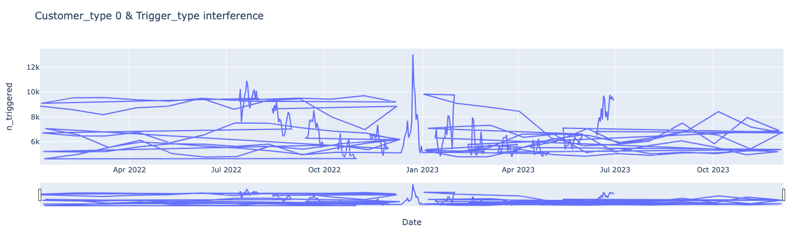
Plotting Time Series
Used Plotly libraries to plot the TS ,for all Customer Type and Trigger Type Combinations , a sample shown below

Slide 4
Algorithm and Approach
The idea is to use Isolation Forest with the flexibility of efficient build of tree and simple understanding
Important parameter are to think of contamination value , I have talk 1% as parameter , as I don’t assume the data is showing anomaly very frequently.
Adjusted the threshold a few times to get right results , settled for -0.1 (trail and error (wont affect much though))
Rest of the hyperparameters are pretty much standard.
I have used the trigger column values as direct feed to the model , we can use some calculated features as well (like Standard deviation and Mean , to get more accurate)

Slide 5
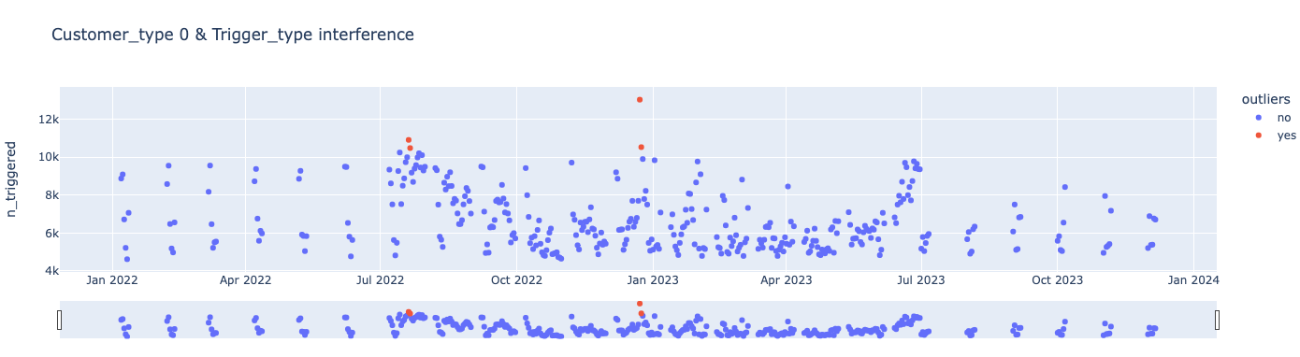
Implementation and Results
Used the sklearn Libraries for Isolation forest and built a few custome functions to make the data flow through to all our cases
Storing and extracting the results for validation and learning if the algorithm is predicting the obvious anomalies
Below show post time series highlighting the outliers

Slide 6
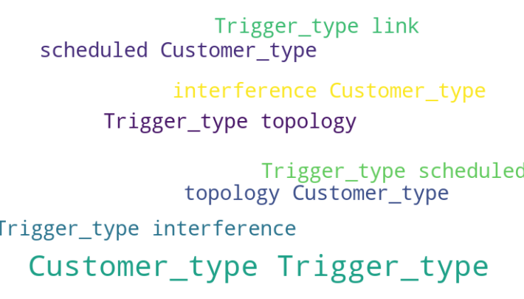
Combinations with Highest Anomalies – Trigger and Customer Type

Slide 7
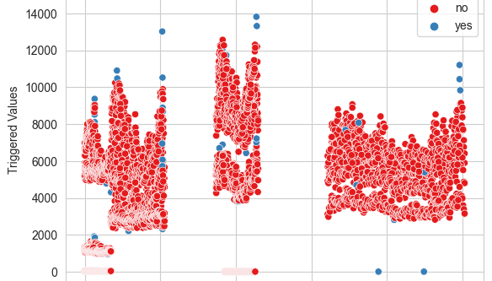
Overall Anomaly Plot
Overall Scatter plot of all points and Triggered value and highlights the anomaly marked data

Slide 8
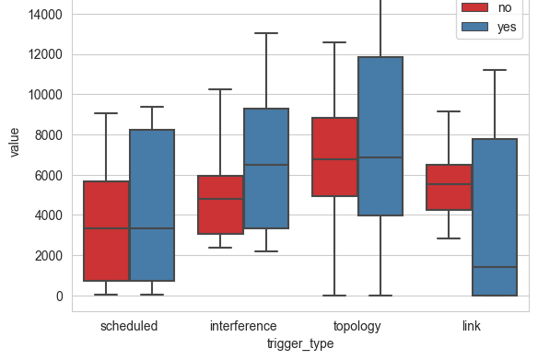
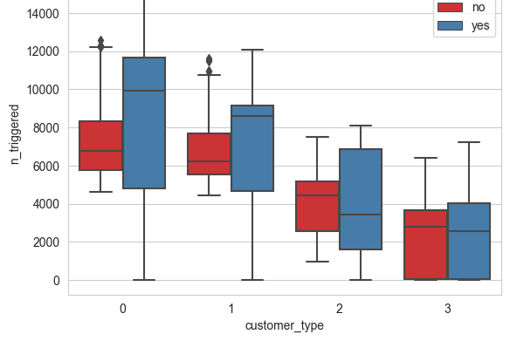
Customer Type and Trigger Type Distribution of anomalies The plots shows clear distinction in outlier and non outlier distributions

Slide 9
Conclusion
The use case is solved with Isolation Forest algo and we have identified and marked a few anomalies in data.
With few more iterations and results affirmations of anomaly marking the model can be tuned a bit further and achieve even better results
Looks like an interesting use case for more sophisticated model build.

